Slide 1
Information Gathering
Gouasmia Zakaria
Gouasmia.zakaria1@gmail.com

Slide 2
What is Information Gathering?
1
In penetration testing, gathering as much information about our target is the first step.
Information gathering or foot printing is of two types namely passive reconnaissance and active reconnaissance.
In passive reconnaissance we gather information without actually interacting with the target systems. Gathering publicly available information about a company from the internet is passive reconnaissance
In active reconnaissance requires interaction with target’s systems..

Slide 3
What is Information Gathering?
2
Port scanning is an example of active reconnaissance.
It is advised to be careful when conducting active reconnaissance on an organization because it is illegal in most countries without approval.
Although there are no hard and fast rules in penetration testing but it is recommended to follow a certain methodology.

Slide 4
In theory foot printing or information gathering is divided into seven steps.
3
The steps along with the best tools to perform them are:
basic Information Gathering
Determining network range
Identifying active machines
Finding open ports
OS fingerprinting
Service fingerprinting
Mapping the network

Slide 5
The steps along with the best tools to perform them are:
4
1 Information gathering Passive
Netcraft, Whois, Nslookup
2 Determining network range Passive
traceart,APNIC, ARIN
3 Identify active machines Active
Ping,traceroute, Angry IP scanner

Slide 6
5
4 Finding open ports Active
Nmap, Zenmap,
5 OS fingerprinting Active/Passive
Nmap, Nessus, RED_HAWK
6 Fingerprinting services Active
FTP, Netcat, SSH, vulnerability scanners
7 Mapping the network Active
scapy , traceroute,visualroute

Slide 7
Basic Information Gathering
6
Gathering initial information about the target is the very first step in the foot printing process.
Collecting different domain names associated with the target company, name servers, IP addresses etc. is the goal here.
A visit to the company’s website can provide us with a lot of useful information.
For example a recent news at their website might say that they have upgraded their systems to windows 2012 and installed cisco switches.

Slide 8
Information Gathering Netcraft, Whois, Nslookup
7
Netcraft is a UK based website that basically tracks and collects details about almost every website on the internet. link www.netcraft.com .
used for A quick search about any website provides us with a host of useful information.
Example : www.whut.edu.cn

Slide 9
Information Gathering Netcraft, Whois, Nslookup
8
Whois
The Whois Tool is a client utility that communicates with WHOIS database servers located around the world to obtain domain registration or IPv4 or IPv6 address assignment information or ASN (autonomous system numbers) ownership

Slide 10
Information Gathering Netcraft, Whois, Nslookup
9
Nslookup (Name System Lookup) is a tool for querying a domain name server in order to get information regarding a domain or host, and diagnosing any configuration problems that may have arisen on the DNS.
When used without any arguments, the command nslookup displays the name and IP address of the primary domain name server, as well as a command prompt for making queries
nslookup whut.edu.cn

Slide 11
Determining network range traceroute, APNIC, ARIN, RIPE NCC
10
After getting the necessary information like names, email addresses , name severs and IP addresses we now need to determine the network range or the subnet mask.
An ip address consists of two parts namely network portion and host portion, devices on the same network have same network portion but different host portions.
A subnetmask is used to identify which part of an ip is network and which is host.

Slide 12
Determining network range traceroute, APNIC, ARIN, RIPE NCC
11
now lets discuss about the tools to find out the network ranges.
The easiest way to find the network range is to use
the ARIN/APNIC/ RIPE NCC whois search.
Link https://www.arin.net link https://www.apnic.net/
There are three RIRs, each maintaining a whois database holding details of IP address registrations in their regions. The RIR whois databases are located at:
ARIN (the Americas and sub-Saharan Africa)
APNIC (Asia Pacific region)
RIPE NCC (Europe and northern Africa)

Slide 13
ARIN/APNIC/ RIPE NCC
12
What does the ARIN/APNIC/ RIPE NCC Whois database contain?
The ARIN/APNIC/ RIPE NCC Whois Database contains registration details of IP addresses and AS numbers originally allocated by APNIC. It contains details of the organizations that hold the resources, the country where the allocations were made, and contact details for the networks. The organizations that hold those resources are responsible for updating their information in the database.

Slide 14
ARIN/APNIC/ RIPE NCC
13
What do the query results mean?
Which are the most important parts to look at ?
For spam and hacking complaints, you really only need to consider the admin-c and tech-c fields and lot of other information .

Slide 15
ARIN/APNIC/ RIPE NCC
14
Are there any exceptions?
Yes
NIR | Country | Whois Database
CNNIC | China | Refer to APNIC Whois Database
JPNIC | Japan | http://whois.nic.ad.jp/cgi-bin/whois_gw
KRNIC | Korea | http://whois.nic.or.kr/english/
TWNIC | Taiwan | http://www.twnic.net/English/Index.htm

Slide 16
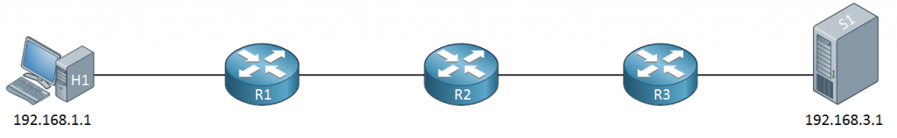
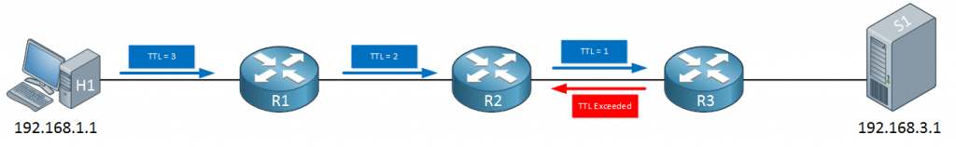
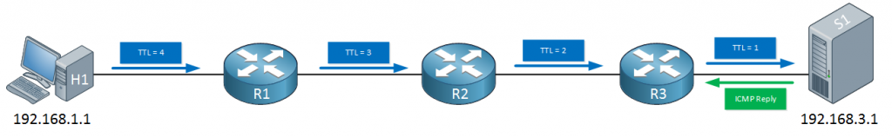
Determining network range traceroute, APNIC, ARIN, RIPE NCC
15
Traceroute, like the ping command can be used to isolate problems in our network. The ping command is a bit limited sometimes. For example, take a look at the following topology:
Notes:
When we send a ping from H1 (192.168.1.1) to S1 (192.168.3.1) and this ping doesn’t work, what does it mean? We’ll know something is not working but we don’t know whether the problem is in between H1-R1, R1-R2, R2-R3 or R3-S1.
If you know the IP addresses of all routers in the path then you could ping all of these routers one by one. What if you have no idea how many routers are in between? Or if you don’t know their IP addresses?
The traceroute command will help us with that.

Slide 17
Identifying active machines Ping,traceroute, Angry IP scanner
16
Next step is identifying the active machine in the target network.
A simple ping command can help us identify the active machines but it takes a lot of time identifying each machine individually.
we need to conduct a ping sweep for this.
There are several programs for conducting a ping sweep but the one I recommend is angry ipscanner.
Notes:
We just need to put in the ip range and it identifies all the active machines.
There are a host of other features like open port scanner, web detect, mac vendor detection, mac adresses fetcher etc.
For now we will concern ourselves with the indentification of active machines.

Slide 18
Finding open ports and OS fingerprinting Nmap, Zenmap, Nessus
17
After finding out the network range and the list of active machines, we can proceed further to identify the open ports and access points along with the OS the devices are running.
The process of identification of the OS is called OS fingerprinting.
One of the most common and useful port scanning tools is Nmap, although it is not the only one.

Slide 19
Finding open ports and OS fingerprinting Nmap, Zenmap, Nessus
18
Nmap is the most popular port scanning tool out there.
It can perform a wide array of scans like TCP intense scan plus UDP port scan, TCP stealth scan, OS fingerprinting etc.. and can also load custom scripts.
Nmap also allows us to customize the speed of the scans.
You can discover more using Nmap -h
When using nmap for scanning, it displays all the open, closed or filtered ports along with the service name and protocol.
https://nmap.org

Slide 20
Finding open ports and OS fingerprinting Nmap, Zenmap, Nessus
19
Zenmap is the GUI of Nmap

Slide 21
Finding open ports and OS fingerprinting Nmap, Zenmap, Nessus
20
Nessus is the world’s most widely-deployed vulnerability assessment solution. Nessus quickly and accurately identifies vulnerabilities, configuration issues and malware in physical, virtual and cloud environments to help you prioritize what to fix first. Combine Nessus with Kali Linux to build a superior pen testing toolkit that provides deep insight into your network systems.
You can start Nessus Scanner by typing /etc/init.d/nessusd start

Slide 22
Using Nessus in a penetration test
21
Nessus reports on host discovery, vulnerability detection and exploitability. Here are some of the ways that Nessus can be used to support penetration testing:
Remediation prioritization and newsworthy vulnerabilities
Finding Heartbleed, Shellshock or other newsworthy vulnerabilities may be important when assessing an organization’s security posture and reporting to the security leadership team.
Detecting default credentials
Use credentials harvested from other phases of testing to perform credentialed patch audits, local (client-side) application vulnerability scanning, and discovery of interesting configurations on targets.

Slide 23
Using Nessus in a penetration test
22
Hunting for web shells
A web server may already be compromised without the administrator even knowing about it. Nessus can help in the detection of compromised hosts.
Modify a vulnerability’s severity
Identify low-severity vulnerabilities and allow an admin-level user to re-cast them as critical vulnerabilities. Modifying the severity of a vulnerability empowers testers to raise the visibility of lower severity findings that often lead to serious exposures.

Slide 24
Nessus in the Lab
23
When it comes to network security, most of the tools to test your network are pretty complex. Nessus isn’t new, but it definitely bucks this trend. It’s incredibly easy to use, works quickly, and can give you a quick rundown of your network’s security at the click of a button
Notes:
If someone wanted to hack your local network, the first thing they’d do is run a vulnerability scan, then they’d run a penetration test. A vulnerability scan digs through the various devices on your network and looks for potential holes, like open ports, outdated software with known vulnerabilities, or default passwords on devices. If they find anything, a hacker would test those vulnerabilities, then find a way to exploit them. Testing these vulnerabilities is a two-step process because a scan just reveals the possibility of problems, a penetration test verifies that the problem is actually exploitable.

Slide 25
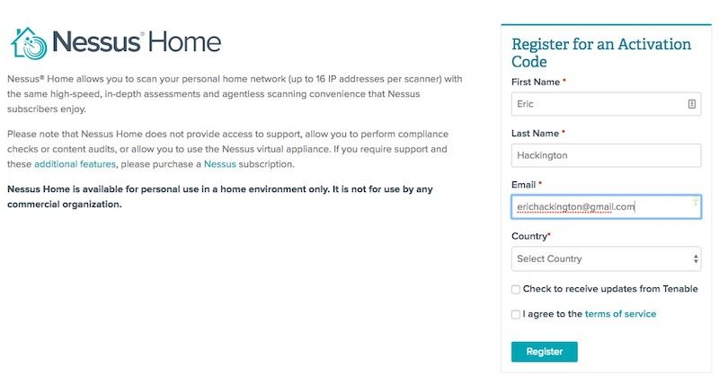
Step One: Download and Install Nessus
24
Notes:
In order to download Nessus, you’ll first need to sign up for an online account so you can download the software and get an activation code.

Slide 26
Step Two: Set Up Your Nessus Account and Activation Code
25
Once Nessus is installed, point your web browser to:
https://localhost:8834/ This is where we’ll complete the signup process and activate your copy of Nessus.
Next, Nessus will download a number of tools and plugins so it can properly scan your network with updated utilities. This can take a few minutes, so grab a cup of coffee and make yourself comfortable.
Notes:
Nessus creates a local server on your computer and runs from there, so don’t be surprised that the installation process is a little different than you’re used to.
1-When you launch Nessus for the first time, you get a “Your connection is not secure” warning from your browser. Click “Advanced” and then “Proceed to localhost” to bypass this warning.
2-Create an account on the Account Setup screen, leave the Registration as “Home, Professional, or Manager,” and then enter the Activation Code from your email. Click “Continue.”

Slide 27
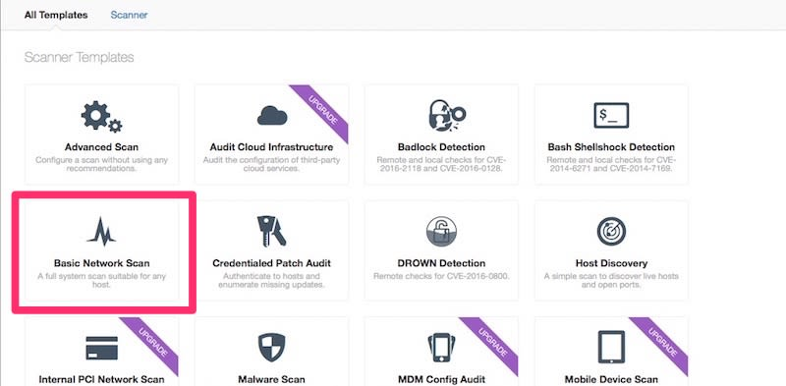
Step Three: Start a Vulnerability Scan
26
Notes:
It’s time to actually test your network. This is the fun part. Nessus can actually scan for quite a few different problems, but most of us will be content using the Basic Network Scan because it offers a good overview.
1-Click the “New Scan.”
2-Click “Basic Network Scan.”
2-Name your scan and add a description.
4-In the “Targets” field, you’ll want to enter IP scanning details about your home network. For example, if your router is at 192.168.0.1, you’d want to enter 192.168.0.1/24. This will make it so Nessus scans all the devices on your network (unless you have a ton of devices this is probably as high as you’d need to go). If you’re not sure about the local IP address for your router, here’s how to find it.
5-Click “Save.”
On the next screen, click the Play icon to launch the scan.
Aside from the Basic Network Scan, you can also run an Advanced Scan that includes more parameters to narrow your search, a Badlock Detection scan, which hunts down a security issue with SAMBA, a Shellshock scan that looks for vulnerabilities in old Linux or Mac machines, a DROWN scan that looks for computers hosting sites susceptible to DROWN attacks, and a few other more acute scans. Most of these issues will also get picked up with the Basic Network Scan, but if you’re doing anything beyond just maintaining a normal home network, like running a private server that’s exposed to the Internet, then you’ll want to double-check that everything is up-to-date using the more specific scanning modes. The rest of us will be fine with the Basic Network Scan.

Slide 28
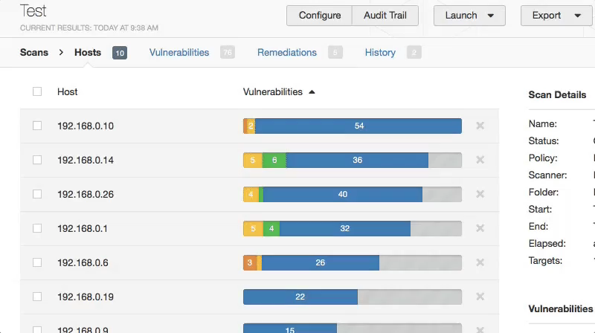
Step Four: Make Sense of the Results
27
Notes:
Once Nessus finishes, you’ll see a bunch of color-coded graphs for each device (referred to as hosts) on your network. Each color of the graph signifies the danger of a vulnerability, from low to critical.
Your results should include all the devices on your local network, from your router to your Wi-Fi-enabled printer. Click the graph to reveal more information about the vulnerabilities on each device. Vulnerabilities are listed as “plugins,” which is just Nessus’ way of discovering vulnerabilities. Click on any plugin to get more information about the vulnerability, including white papers, press releases, or patch notes for potential fixes. You can also click the Vulnerabilities tab to see an overview of all the potential vulnerabilities on the network as a whole.
Take a second to click the link on each vulnerability, then read up on how a hacker could exploit it. For example,

Slide 29
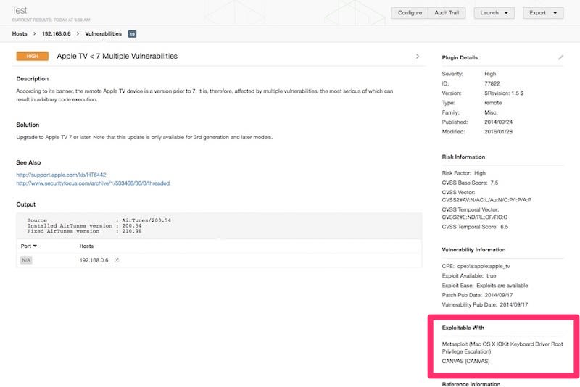
Step Five: What to Do Next
28
Notes:
Nessus gives you all this data, but what exactly are you supposed to do with it? That depends on which vulnerabilities Nessus finds.

Slide 30
Service fingerprinting FTP, Netcat, SSH, telnet
29
In some of our previous scans, we saw some of the ports and the services associated were open.
If we only knew which ports were open, the respective services could be easily displayed by banner grabbing.
Banners can be easily grabbed by simply by using telnet or FTP.
By simply telnetting into the port we could see which type of service and version of the software the device is running.
Also one of the easiest way of banner grabbing is by using netcat

Slide 31
30
ftp ftp.xxxxxxxxx.com
telnet –o 192.168.1.1
Nc -192.168.1.1 (port number)
Etc.. And more tools to brut force those ports

Slide 32
Mapping the network scapy , traceroute, visualroute
31
Now we can finally map the network to provide us with the blueprint of the company.
We can use good old fashioned traceroute or a more graphical an interactive tool.
One such tool is visualroute.

Slide 33
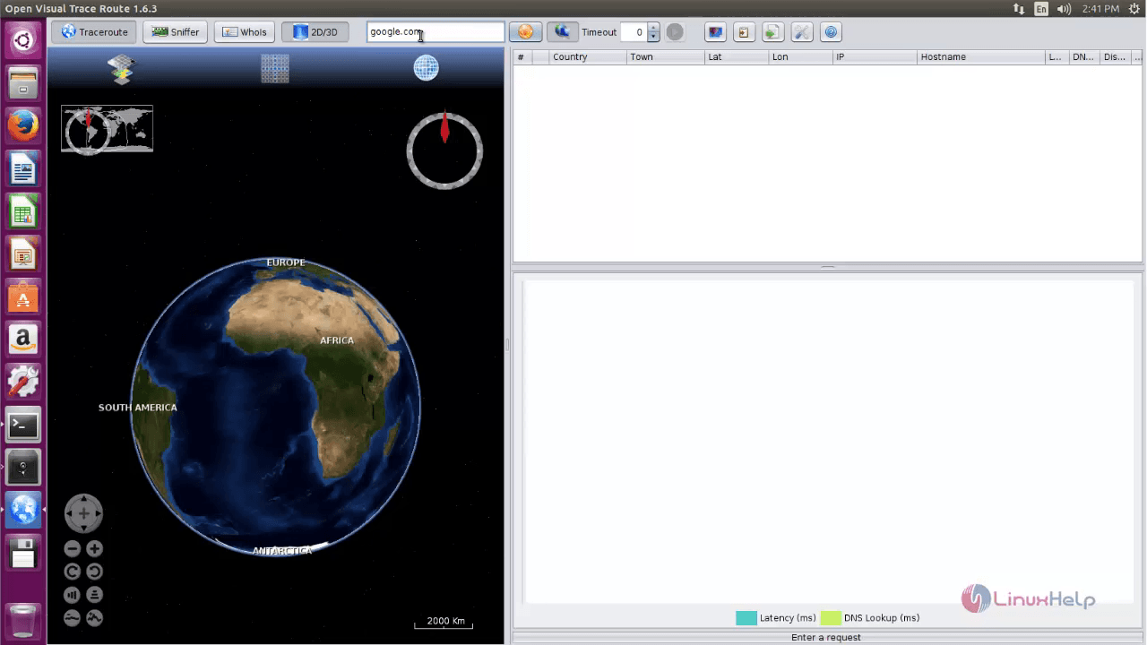

Slide 34
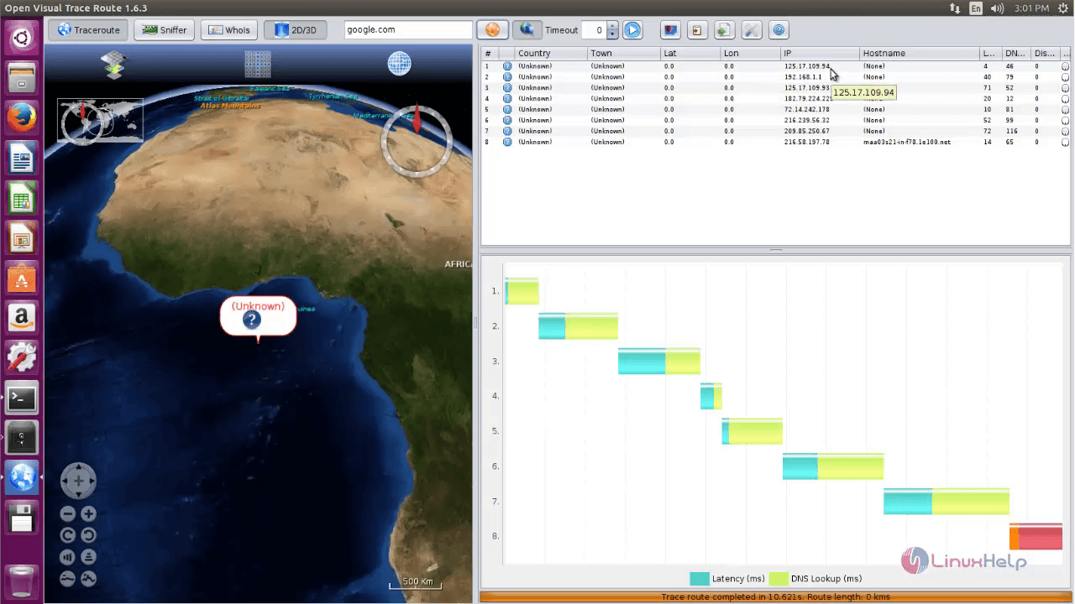

Slide 35
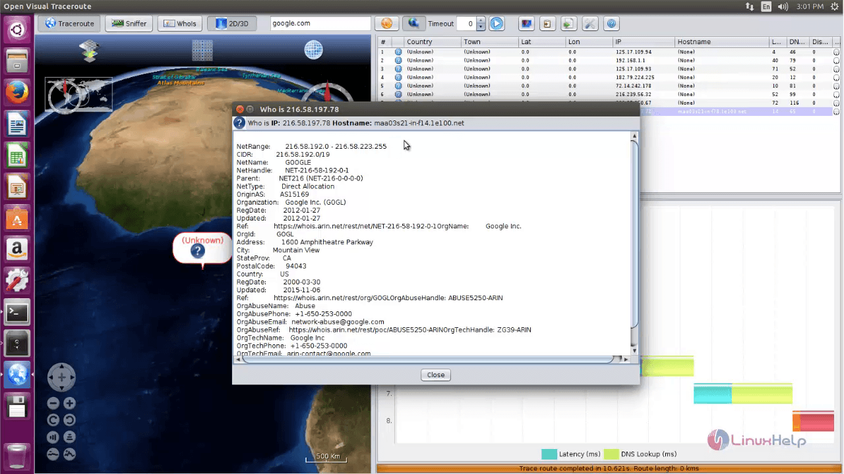

Slide 36
Mapping the network scapy , traceroute, visualroute
35
Scapy is a powerful interactive packet manipulation program
forge or decode packets of a wide number of protocols
send packets on the wire, capture them, match requests and replies
classical tasks like scanning, tracerouting, probing, unit tests, attacks or network discovery
performs very well at a lot of other specific tasks that most other tools can’t handle
See interactive tutorial and the quick demo: an interactive session (some examples may be outdated).
Notes:
Scapy is a powerful interactive packet manipulation program. It is able to forge or decode packets of a wide number of protocols, send them on the wire, capture them, match requests and replies, and much more. It can easily handle most classical tasks like scanning, tracerouting, probing, unit tests, attacks or network discovery (it can replace hping, 85% of nmap, arpspoof, arp-sk, arping, tcpdump, tethereal, p0f, etc.). It also performs very well at a lot of other specific tasks that most other tools can’t handle, like sending invalid frames, injecting your own 802.11 frames, combining technics (VLAN hopping+ARP cache poisoning, VOIP decoding on WEP encrypted channel, …), etc. See interactive tutorial and the quick demo: an interactive session (some examples may be outdated).

Slide 37
Usage
36
Starting Scapy
Scapy’s interactive shell is run in a terminal session. Root privileges are needed to send the packets, so we’re using
os
linux | $ sudo ./scapy Welcome to Scapy (2.4.0) >>>
windows | C:\>scapy Welcome to Scapy (2.4.0) >>>
Kali linux | $ scapy

Slide 38
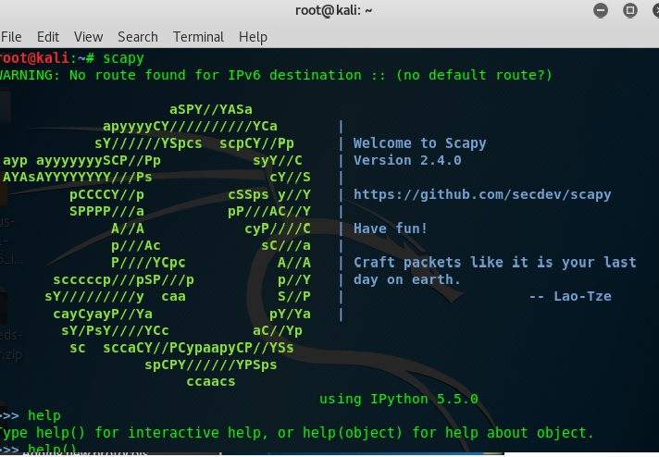
Kali linux
37

Slide 39
Last Tool ALL in one
38

Slide 40
Last Tool is RED_HAWK
39
RED HAWK’s is All in one tool for Information Gathering, Vulnerability Scanning and Crawling. A must have tool for all penetration testers. red hawk’s having so many options like given below.
Basic Scan
Whois Lookup
Geo-IP Lookup
Grab Banners
DNS Lookup
Subnet Calculator
Nmap Port Scan
Sub-Domain Scanner
Reverse IP Lookup & CMS Detection
Error Based SQLi Scanner
Bloggers View
WordPress Scan
Crawler
MX Lookup

Slide 41
RED_HAWK
40
Download red hawk’s from github
git clone https://github.com/Tuhinshubhra/RED_HAWK.git
Then change to red hawk directory: cd RED_HAWK
To run : php rhawk.php

Slide 42
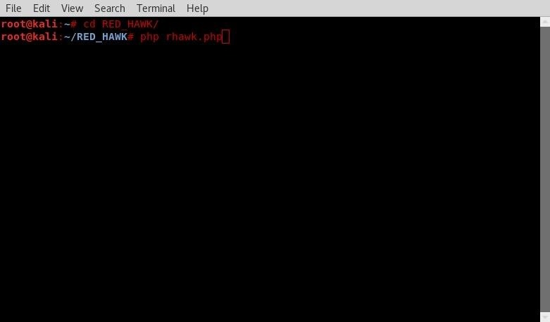

Slide 43
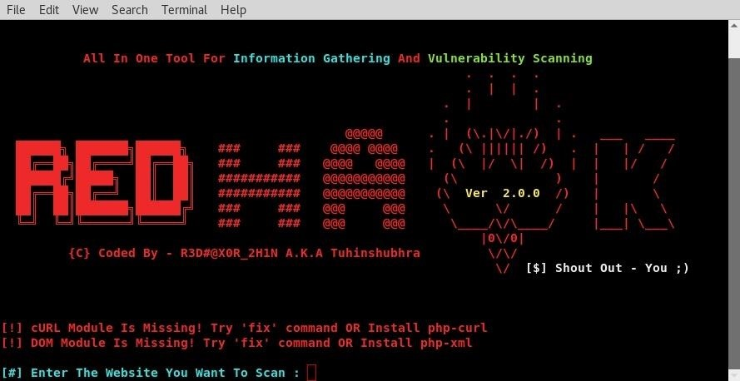
Notes:
Now enter your website and hit enter. Then specify between whether it uses http or https. We now have options of what we would like red hawk to search for. we are going to go with option one. As mapping out our target site is one of the first steps in pentesting, using red hawk can easily help speed up this process by having these tools in one place.

Slide 44
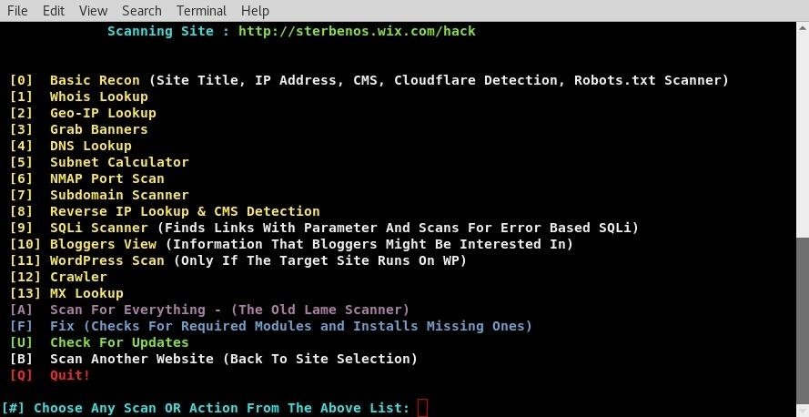
Notes:
As you can see red hawk has scanned our target site. From these we learned the target site does not use cloudflare ddos protection, runs Pepyaka version 1.13.10 ect. This is all useful information for mapping out target and from there trying to find ways we can attack. To use it agin just enter php rhawk.php from the same terminal. if you closed it change directories to RED_HAWK/ agin. Thats all for today folks, get to scanning !

Slide 45
